Slide 1
Cell Growth and Division
Honors Biology

Slide 2
Sexual vs Asexual Reproduction
Most cells in the human body will need to undergo cell division, the process that cells use to reproduce themselves.
Two Types:
Somatic cell division (soma=body) division of any cell in the body other than a germ cell (a.k.a. a gamete) for repair and growth. Takes place during a process called mitosis.
Reproductive cell division produces gametes (sperm and egg). Uses a process called meiosis.

Slide 3
Sexual vs Asexual Reproduction
Sexual Reproduction: produces genetically diverse offspring from 2 parents
Ex: giraffes
Advantages:
Changing environments
Provides genetic diversity
Disadvantages:
Takes longer to find a mate
Asexual reproduction: produces genetically identical offspring from single parent
Ex: bacteria
Advantages:
in stable environments
reproduce faster
Disadvantages:
In changing environments all individuals equally susceptible

Slide 4
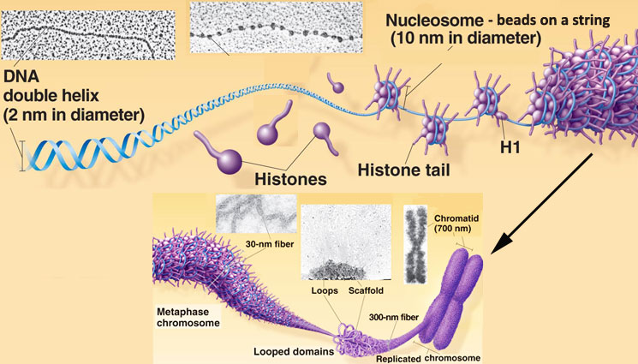
Chromosomes
Chromatin: uncoiled DNA and proteins
Before the cell can divide the DNA must be “packaged”
How are Chromosomes formed?
In eukaryotes, the DNA wraps tightly around proteins called histones
only visible during Cell Division

Slide 5
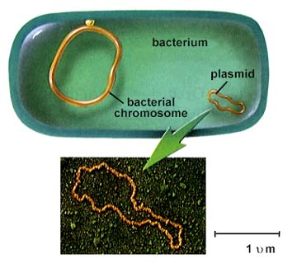
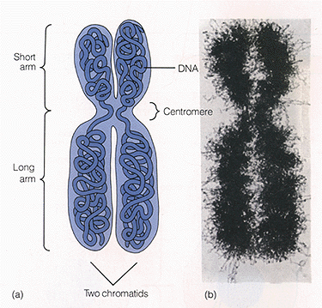
Prokaryotes verse Eukaryotes
Prokaryotes typically have a single circular chromosome
Eukaryotes have multiple linear chromosomes

Slide 6
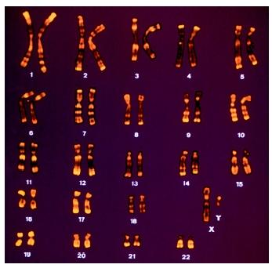
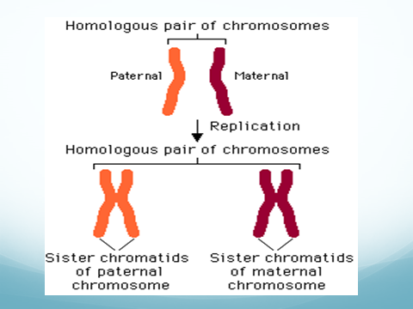
Types of Chromosomes
Karyotype
Humans have
46 chromosomes in each of their somatic (body) cells
44 of these are classified as autosomes
Found as homologous pairs
Chromosomes that are the same size, shape and contain genes for the same traits (one from mom, one from dad)
2 of these are sex chromosomes
(XX= female XY= male)
Somatic cells are diploid (2N) because they have both sets of chromosomes

Slide 7
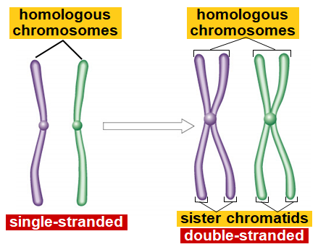

Slide 8
Types of Chromosomes

Slide 9
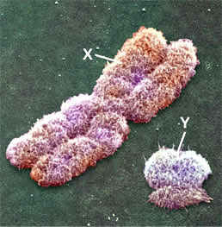
Sex cells have 23 chromosomes
These cells are haploid (N) because they only contain 1 set of chromosomes
After fertilization
sperm 23 + egg 23 = zygote 46

Slide 10
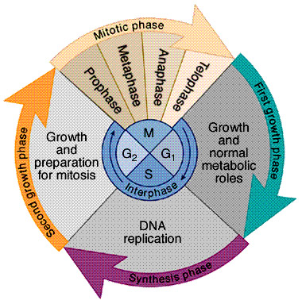
The Cell Cycle
3 stages
Interphase
Mitosis
Cytokinesis
You have this diagram in the back of your notes.

Slide 11
Interphase
Longest stage of the cell cycle
Divided into 3 phases
G1 phase
Period of growth
Does its “job” (makes proteins)

Slide 12
Interphase
S phase
DNA is copied
AKA DNA Replication

Slide 13
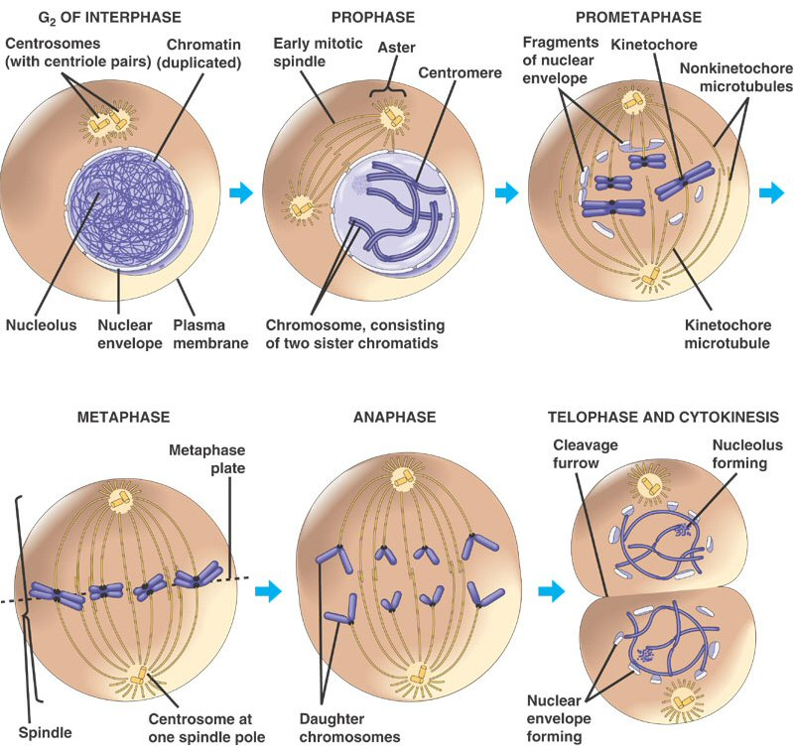
Interphase
G2 phase
Copies organelles and gets ready to divide
You have these diagrams in the back of your notes.

Slide 14
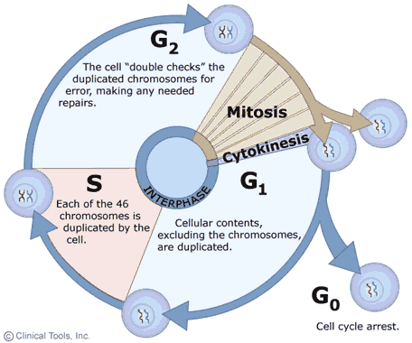
Interphase
G0 phase
Non-dividing phase
Ex: brain cells

Slide 15
Mitosis: IPMAT
Prophase
Chromatin coils to form chromosomes
Nuclear envelope and nucleolus begin to break down
Centrioles move to opposite poles and begin to produce spindle fibers
Spindle fibers attach to centromere of each chromosome
Plant cells do this too even though they do not have centrioles

Slide 16
Mitosis
Metaphase
Spindle fibers move chromosomes to line up in the center (equator) of the cell

Slide 17
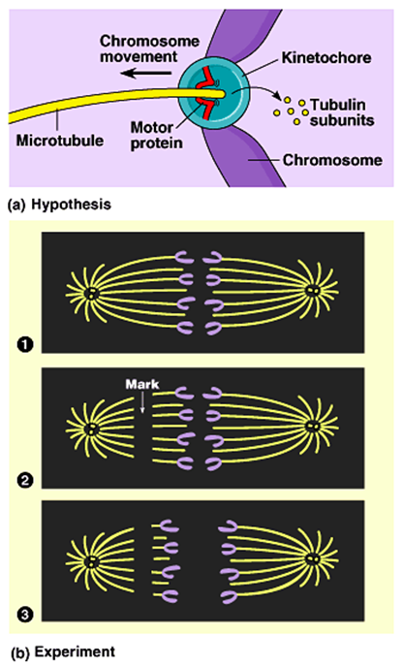
Mitosis
Anaphase
Spindle fibers pull the centromeres apart allowing the sister chromatids to separate
pulled by motor proteins “walking”along microtubules
microtubule shortens by dismantling at kinetochore (chromosome) end
The phase ends when the chromatids reach the poles or stop moving

Slide 18
Mitosis
Telophase
Nuclear envelop and nucleolus reform
Chromosomes uncoil into chromatin
Spindle fibers break apart

Slide 19
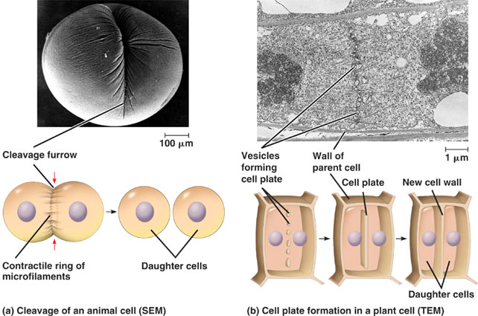
Cytokinesis
Division of cytoplasm
In animal cells, it occurs from the formation of the cleavage furrow
In plant cells, it occurs from the formation of the cell plate
Formed by golgi apparatus

Slide 20
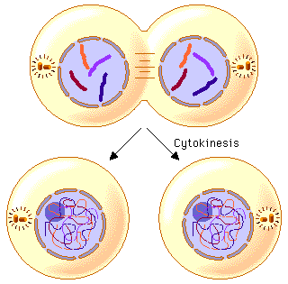
End Product
2 identical Daughter cells
Mitosis Animation

Slide 21
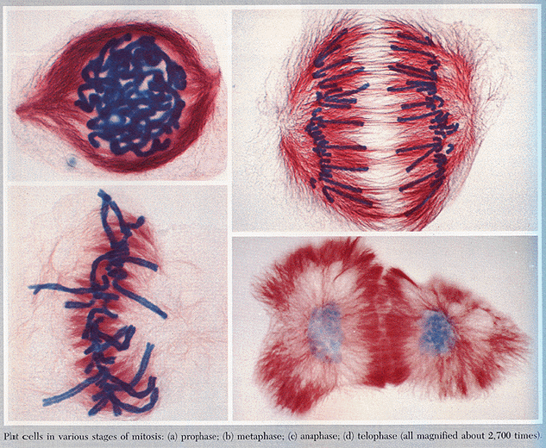
Under the Microscope

Slide 22
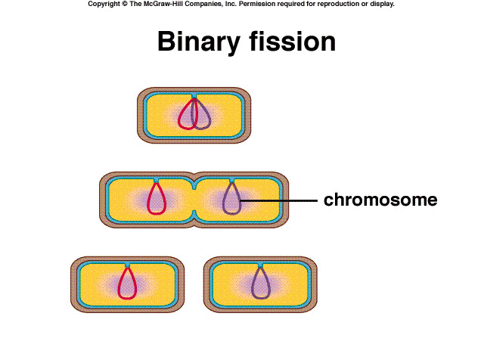
Prokaryote Reproduction
Bacteria reproduce by a process called Binary Fission
Steps
1. DNA is copied
2. Cell gets 2X as big
3. Cell splits
Produces clones

Slide 23
Why are Cells Small?
1. Information overload
Not enough DNA to meet the demands of a large cell
Ex: checking books out of the library

Slide 24
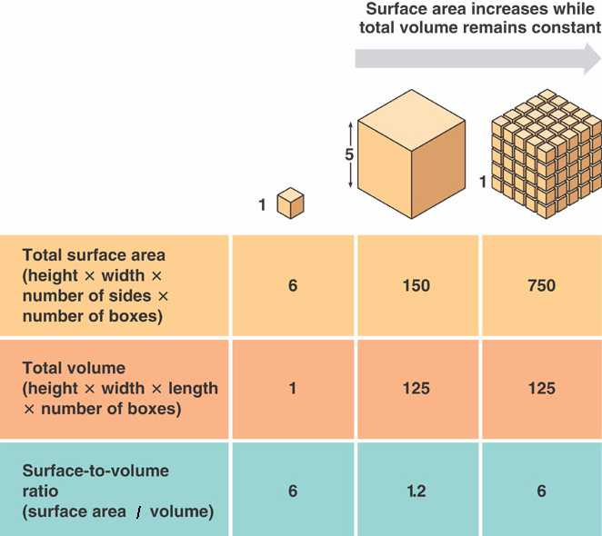
Why are cells small?
2. Surface area to Volume ratio
Cell can not get materials in and out fast enough

Slide 25
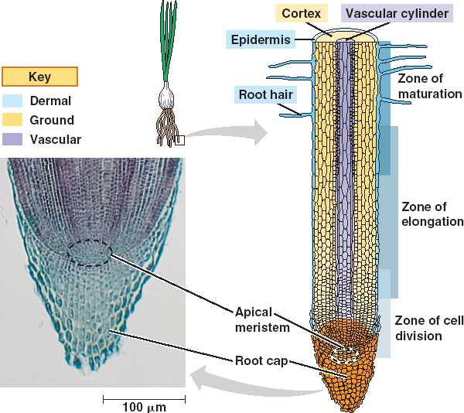

Slide 26
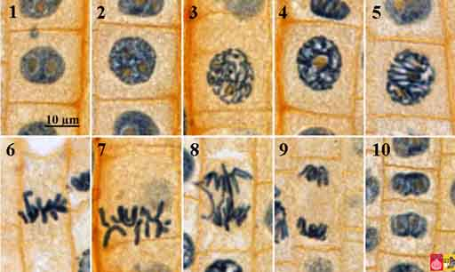

Slide 27
Regulating the Cell Cycle
Cell Type | Life Span | Cell Division
Lining of esophagus | 2-3 days | Yes
Lining of small intestine | 1-2 days | Yes
Lining of large intestine | 6 days | Yes
Red Blood Cells | 120 days | No
White Blood Cells | 10 hrs to decades | Many do not
Smooth muscle | Long-lived | Yes
Cardiac muscle | Long-lived | No
Skeletal Muscle | Long-lived | No
Neuron | Long-lived | NO

Slide 28
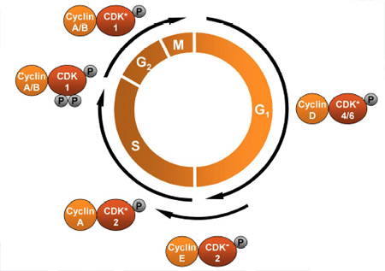
Cell Cycle Regulators
During the early 1980’s scientists discovered the protein cyclin in a dividing cell
This protein regulates the cell cycle
When they injected this protein into a non-dividing cell spindle fibers began to form

Slide 29
Internal Regulators
Proteins that respond to events inside the cell
Some do not allow mitosis to begin until all the chromosomes have been copied
Some do not let anaphase begin until spindle fibers have attached to each chromosome

Slide 30
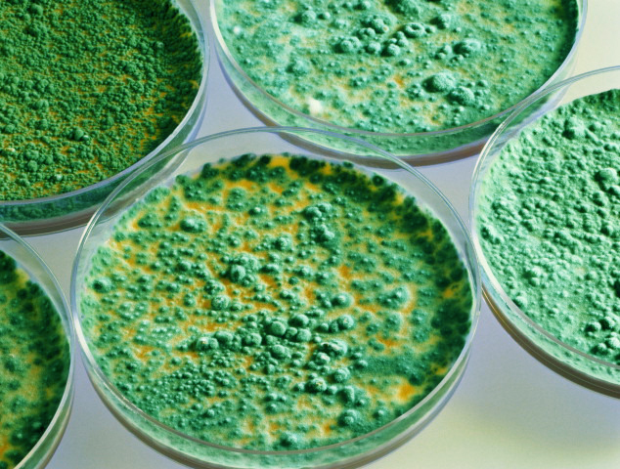
External Regulators
Proteins that respond to events outside the cell
Control the rate of cell cycle
Ex: Growth Factors
Speed up cell cycle
Important during embryonic development and healing
Ex: molecules found on adjacent cells slow down cell cycle to prevent overgrowth of cells

Slide 31
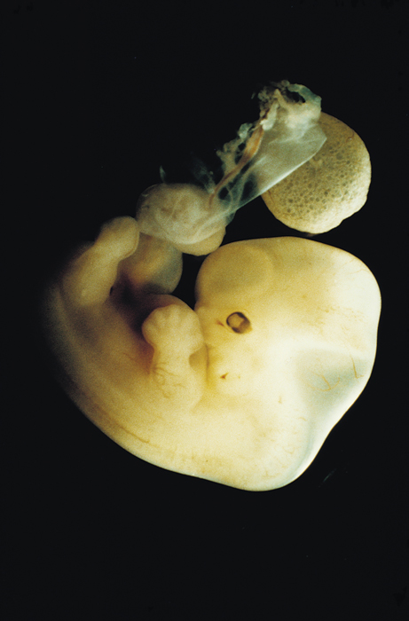
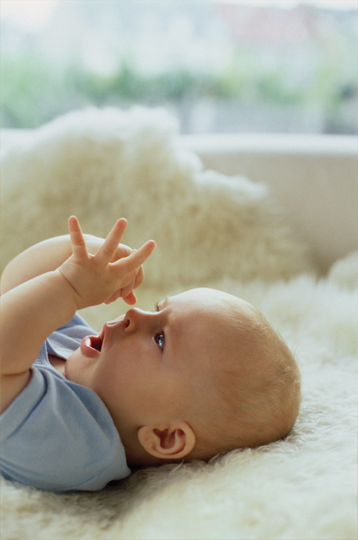
Apoptosis
Programmed cell death
Cell and chromatin shrink
Parts of the cell membrane break off
Neighboring cells get rid of the remains
Ex: webbed fingers
webbed fingers

Slide 32
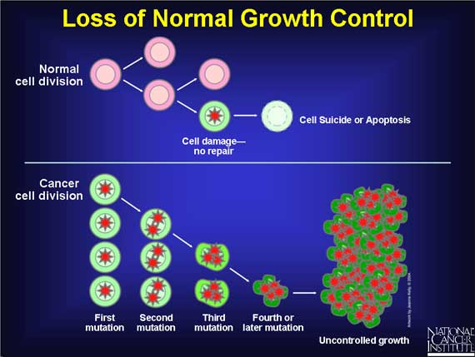
Uncontrolled Cell Growth
Cancer: disorder in which some of the body’s cells lose the ability to control growth
Cells grow into masses called tumors

Slide 33
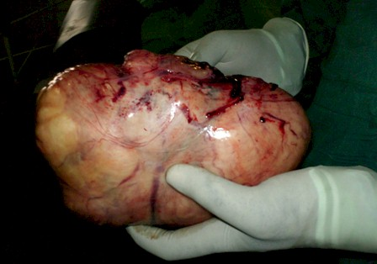
Types of tumors
Benign tumors: cells remain within the mass
Normally harmless unless they grow large enough to interfere with other organs
Ex: fibroid cysts in uterus or breast, warts

Slide 34
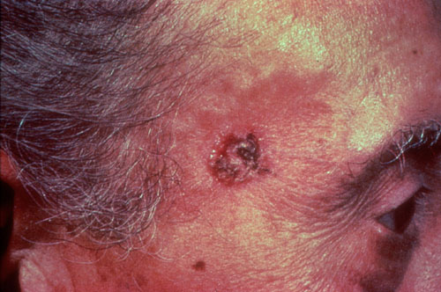
Malignant tumors: cells invade and destroy healthy tissues elsewhere in the body
Metastasis: spread of cancer from original site
Cancer cells break away from original mass and travel to other parts of the body
Categorized by type of tissue they affect

Slide 35
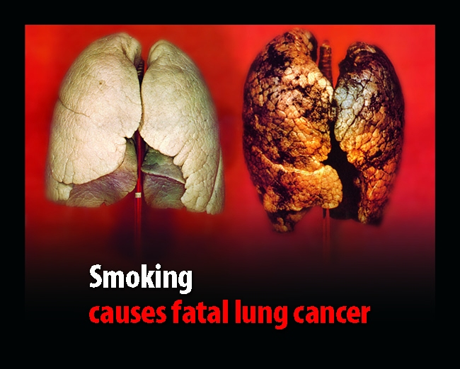
Types of Cancer
Carcinomas: grow in skin and tissues that line the organs of the body
Ex: lung cancer, breast cancer

Slide 36
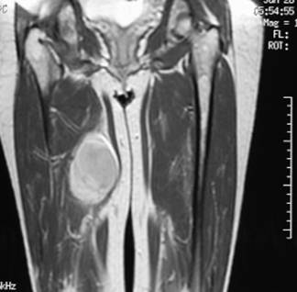
Sarcomas: grow in bone and muscle tissues

Slide 37
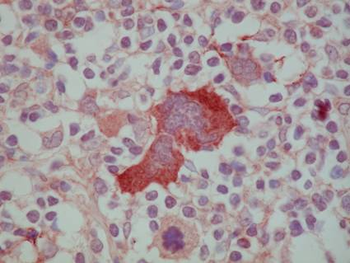
Lymphomas: solid tumors that grow in the tissues that form blood cells
May cause leukemia (the uncontrolled growth of WBC)

Slide 38
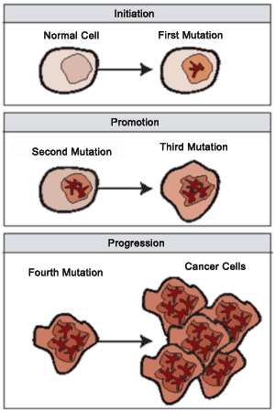
Cancer normally takes several years to develop unless a vital organ such as the liver or pancreas is involved

Slide 39
Causes
Mutations of genes that alter the expression of growth factors
Can happen spontaneously or because of carcinogens (any substance that increase risk of cancer)
Ex: tobacco, asbestos, radiation (x-ray, sun)
Most Carcinogens are mutagens
Some families are at a high risk of developing cancer due to genetics
Ex: p53 gene damage prevents cell from regulating cell cycle
Some bacteria and viruses
Ex: HPV

Slide 40
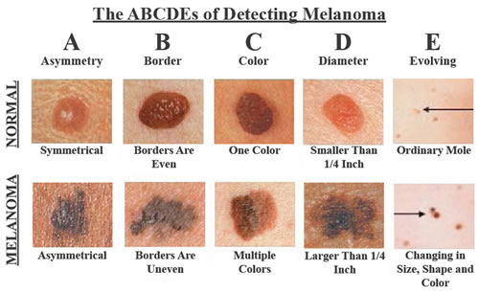
Treatments
Surgery
Radiation
Chemotherapy

Slide 41
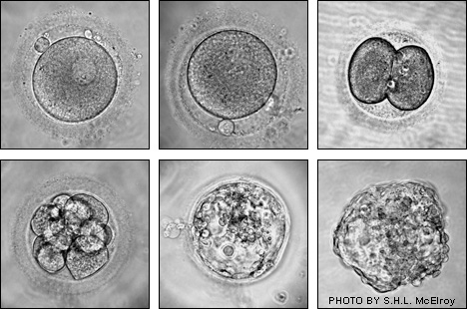
How do you go from a single cell to a multicellular organism with specialized cells?
Embryo: developmental stage in which cells become more specialized
Differentiation: process by which cells become specialized (different)

Slide 42
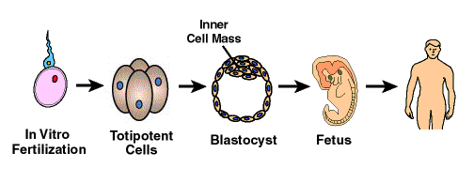
Differentiation in Mammals
Controlled by several factors during embryonic development
Totipotent cells: cells that can develop into any type of body cell and cells of the extraembryonic membrane and placenta
Ex: initial cell after fertilization

Slide 43
Human development
After 4 days of development the single cell has become a hollow ball of cells surrounding a inner cell mass called the blastocyst
The outer cells differentiate to form tissues that attach embryo to the mother
The inner cells become the embryo

Slide 44
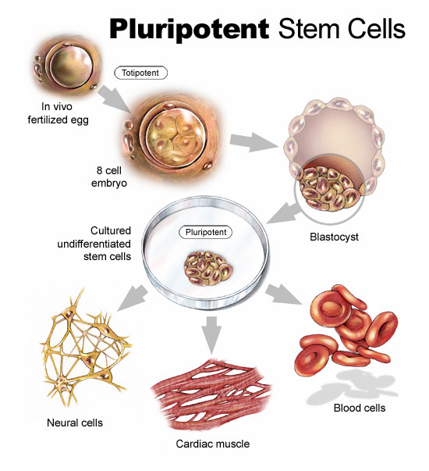
These inner cells are pluripotent
They can develop into many different types of cells but not every type

Slide 45
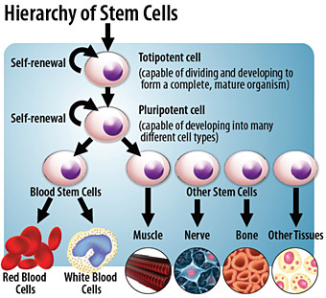
Stem Cells
Unspecialized cells from which differentiated cells develop

Slide 46
Embryonic Stem Cells
Pluripotent cells
Adult Stem Cells
Groups of cells that differentiate to renew and replace old cells
Called multipotent
Ex: stem cells in bone marrow for the different blood cells

Slide 47
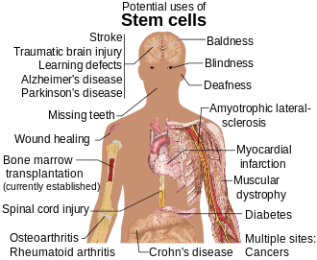
Potential Benefits
Stems cells could be used to repair or replace damaged cells
Ex: repair heart muscle after heart attack

Slide 48
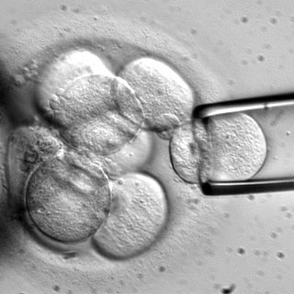
Ethical Issues
Not many with the use of adult stem cell research
With embryonic stem cell research many issue due to the fact that harvesting the cells destroys the embryo
Solution: new techniques that allow cells to be removed without harming the embryo
Reprogram adult stem cells to become pluripotent

