Slide 1
Carbon Compounds
Honors Biology

Slide 2
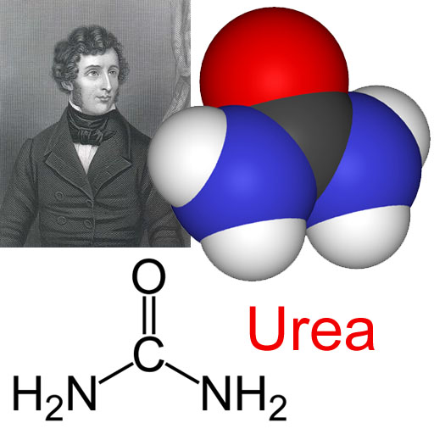
Organic Chemistry
Old belief: living and nonliving things were made of different “stuff”
Organic = living
German chemist (Friedrich Wöhler)in the 1800’s was able to “make” organic compounds from minerals
Organic Chemistry verse Inorganic Chemistry

Slide 3
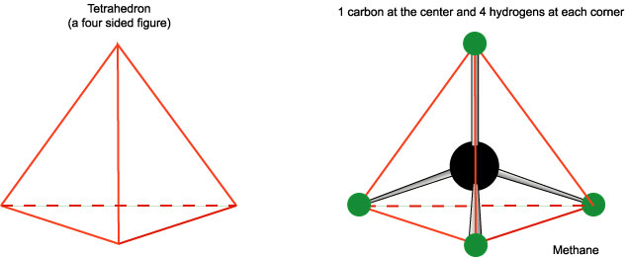
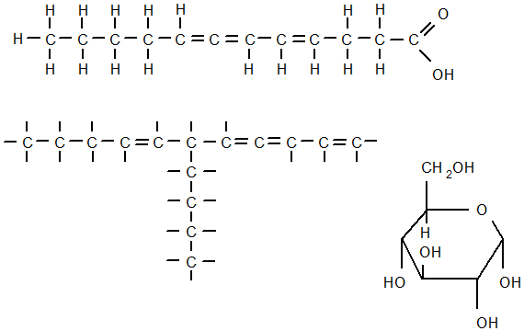
Why is Carbon so special?

Slide 4
Why is Carbon so special?
1. It has 4 valence electrons
can form 4 strong covalent bonds
(ex: Hydrogen, Oxygen, Phosphorus, Sulfur and Nitrogen)
Tetrahedron
2. Carbon atoms can bond to each other to form long chains, or complex rings
Compounds with just carbon and hydrogen are “hydrocarbons”

Slide 5
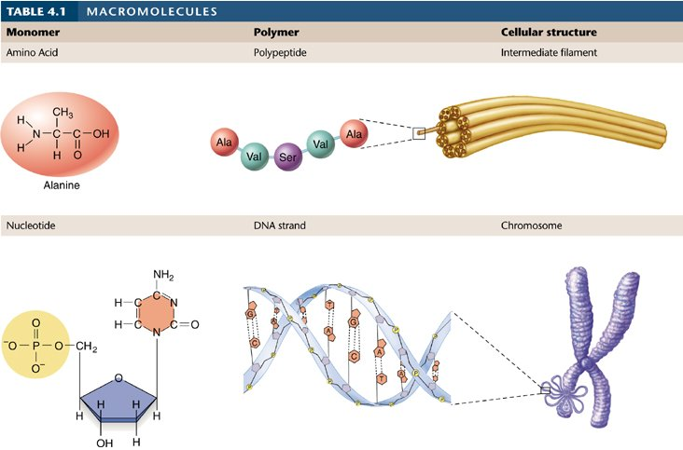
Macromolecules
“giant molecules”
4 main groups
3 formed by a process called Polymerization
Monomers are joined together to form polymers

Slide 6
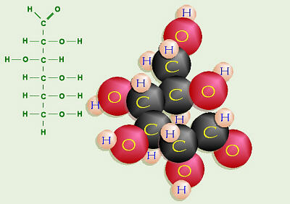
Carbohydrates
Made up of carbon, hydrogen and oxygen
Monomer: monosaccarides
composed of rings of 5 or 6 carbons
alcohol (-OH) groups attached
most are water-soluble
3D Model

Slide 7
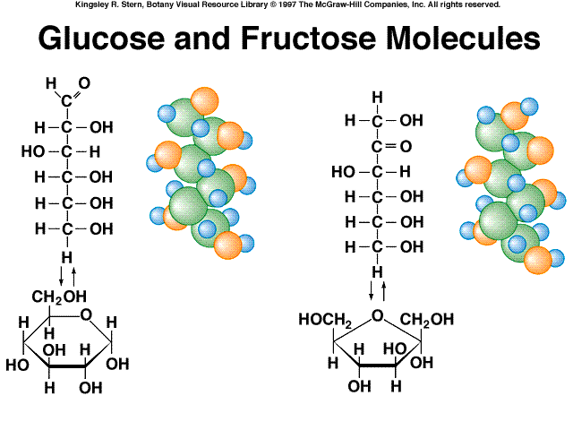
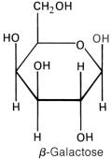
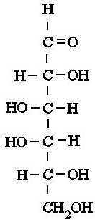
Monosaccharides
Simple sugars have 1 carbon ring
Ex: Glucose (plant sugar)
Galactose (milk)
Fructose (fruits)

Slide 8
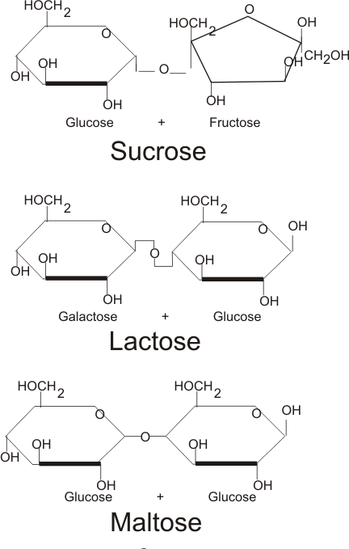
Disaccharides
two simple sugars joined together
Most of the sweet things we eat are disaccharides:
Table sugar is sucrose: glucose + fructose.
Lactose, milk sugar:
glucose + galactose.
Maltose, malt sugar:
glucose + glucose

Slide 9
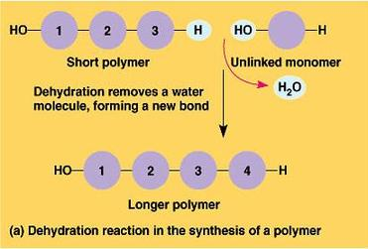
Dehydration reactions form polymers
One monomer loses a H and the other loses a OH
Forms water
Leaves the 2 monomers “unstable” so they join together covalently to regain their stability
Dehydration reaction
AKA Condensation Reactions

Slide 10
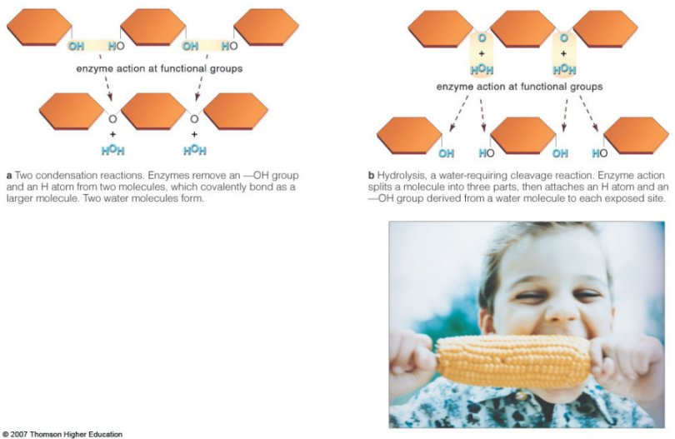
Hydrolysis Reactions break down polymers
Add water
Reverse of dehydration reactions
Hydrolysis of Maltose

Slide 12
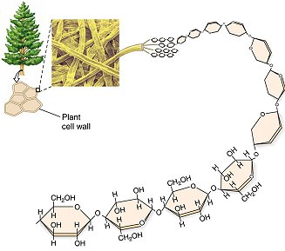
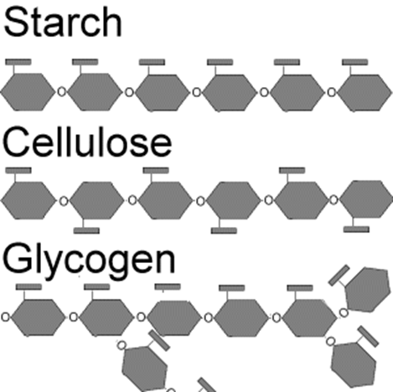
Polysaccharides
many sugars linked together
Can be linear chains or branched.

Slide 13
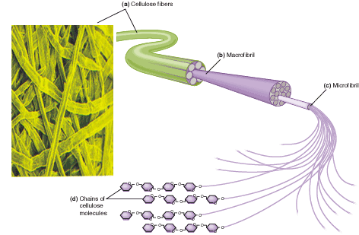
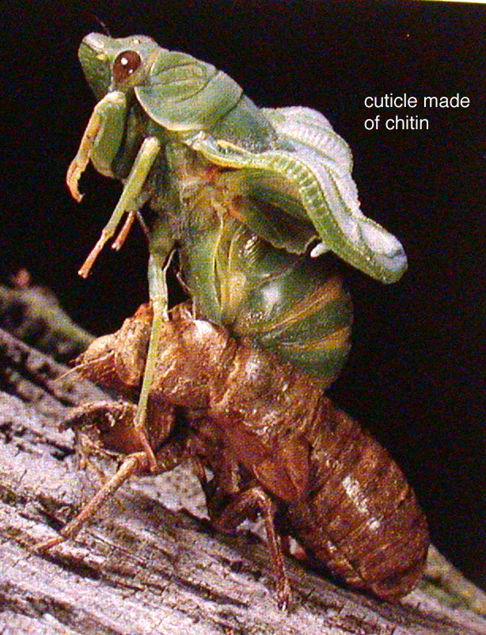
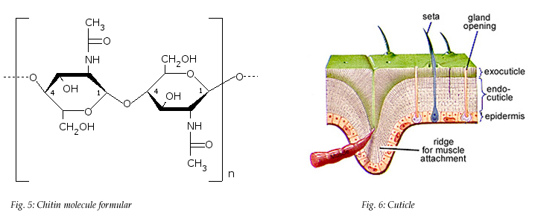
Functions?
1. Plants and some animals use them for structural purposes
the cellulose of plant cell walls
The chitin that covers insects and crustaceans

Slide 14
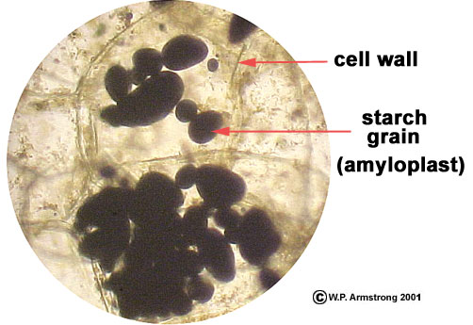
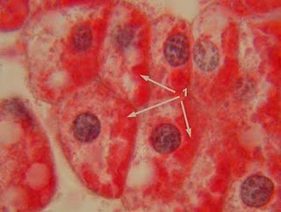
2. Main source of energy for living things
Some is food storage:
Plants = starch
Animals = glycogen (Animal Starch)
Found in liver and muscles
When your blood sugar runs low, glycogen is released from your liver and converted to glucose
How?

Slide 15
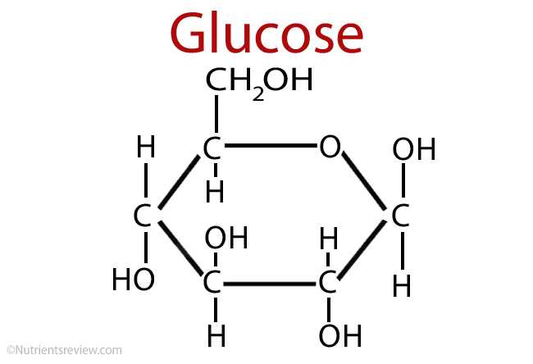
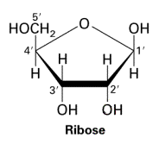
Let’s Review!
Carbohydrates

Slide 16
Lipids

Slide 17
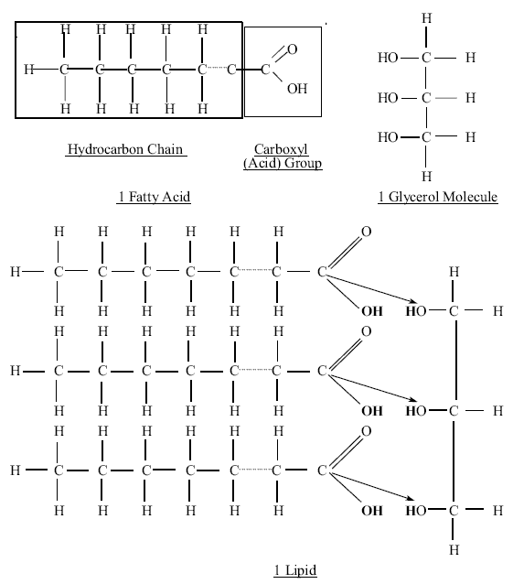
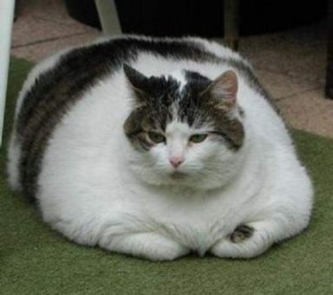
Lipids (not polymers)
non-polar
not soluble
Mostly hydrocarbons
Formed when a glycerol molecule combines with fatty acids
How?

Slide 18
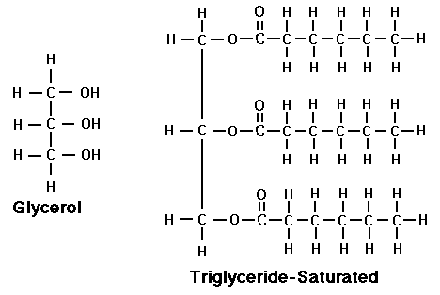
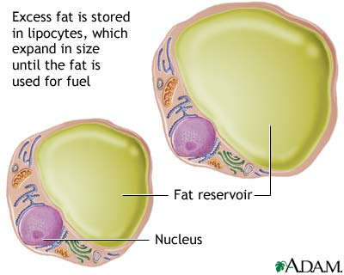
1. Fats/oils
Triglycerides
Glycerol + 3 fatty acids
Calories not used are converted to triglycerides and stored in fat cells
Hormones regulate the release of triglycerides when needed
Excess triglycerides in plasma = hypertriglyceridemia
Linked to coronary artery disease
Function: store about twice as much energy per weight as carbohydrates like starch.

Slide 19
Saturated verse Unsaturated Fats
Saturated: only single bonds in carbon chain
Saturated with the max number of Hydrogen atoms
saturated fat increases blood cholesterol levels and leads to clogged arteries and heart disease
Solid at room temperature
Ex: animal fat

Slide 20
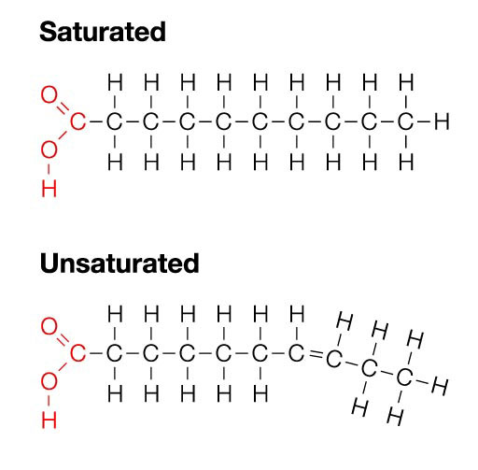
Unsaturated Fats: have at least one carbon-carbon double bond
Polyunsaturated= more than one double bond
Liquid at room temperature
Ex: vegetable oil
Margarine is made by “hydrogenation”
reducing the double bonds back to single bonds by adding in hydrogens
Results in solid margarine instead of liquid vegetable oil.
The Process

Slide 21
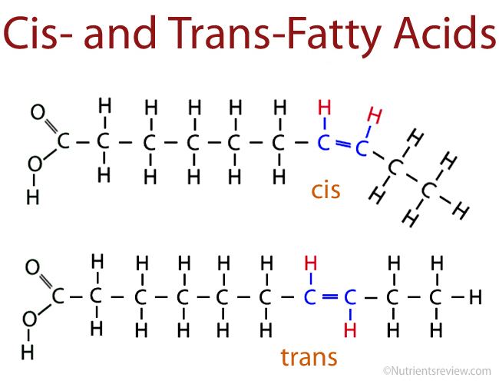
Trans Fats
Several years ago, most companies replaced lard with partially hydrogenated vegetable oil
trans fatty acids proved to be even worse for your health than lard. Oops!

Slide 22
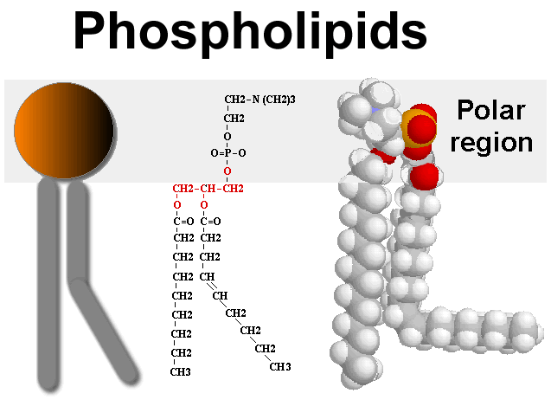
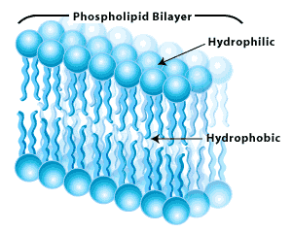
2. Phospholipids
Function: the main component of cell membranes.
Structure: glycerol with 2 fatty acids attached, plus a phosphate-containing “head” group
The head group is hydrophilic (water loving), while the fatty acids are hydrophobic (hydrophobic).

Slide 23
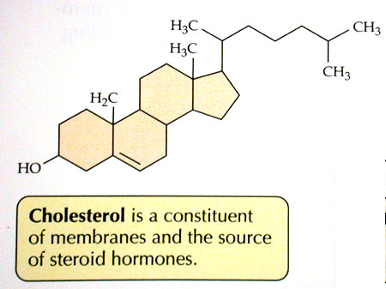
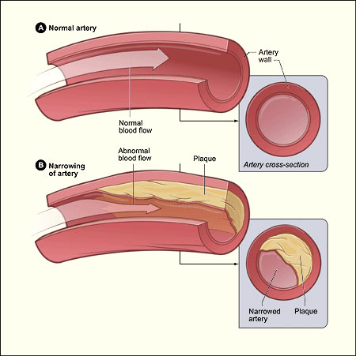
3. Steroids
hydrocarbons with the carbon atoms arranged in a set of 4 linked rings.
Cholesterol is a component of cell membranes (stability)
Can form plaque in blood vessels leading to atherosclerosis (hardening of the arteries in the heart).
Steroid hormones are made from cholesterol.
Including: estrogen, testosterone, vitamin D, cortisone, and many others.

Slide 24
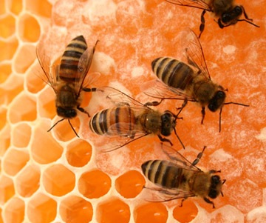
4. Waxes
Waxes: waterproof coating on plants and animals.
Composed of fatty acids attached to long chain alcohols.

Slide 25
Lipid Review
How are lipids defined?
In what type of solvent are they soluble or insoluble?
What are lipid's functions in the body? How are lipids formed?
Compare saturated and unsaturated fatty acids.
How is a phospholipid formed? What is interesting about its structure?
Draw and label a phospholipid.

Slide 26
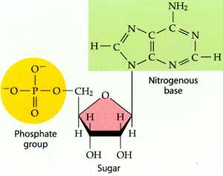
Nucleic Acids
Contain: hydrogen, oxygen, nitrogen, carbon and phosphorus
Monomer= nucleotide
Parts: 5-C sugar, phosphate group, nitrogenous base

Slide 27
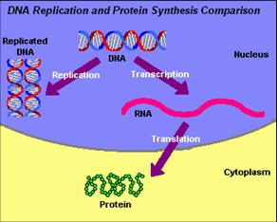
Function?
Store and transmit hereditary or genetic information

Slide 28
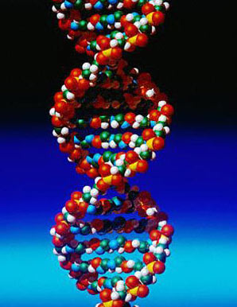
DNA
Deoxyribonucleic Acid
5-C sugar is deoxyribose
Phosphate group
Nitrogenous bases: Adenine, thymine, cytosine, guanine
Double stranded

Slide 29
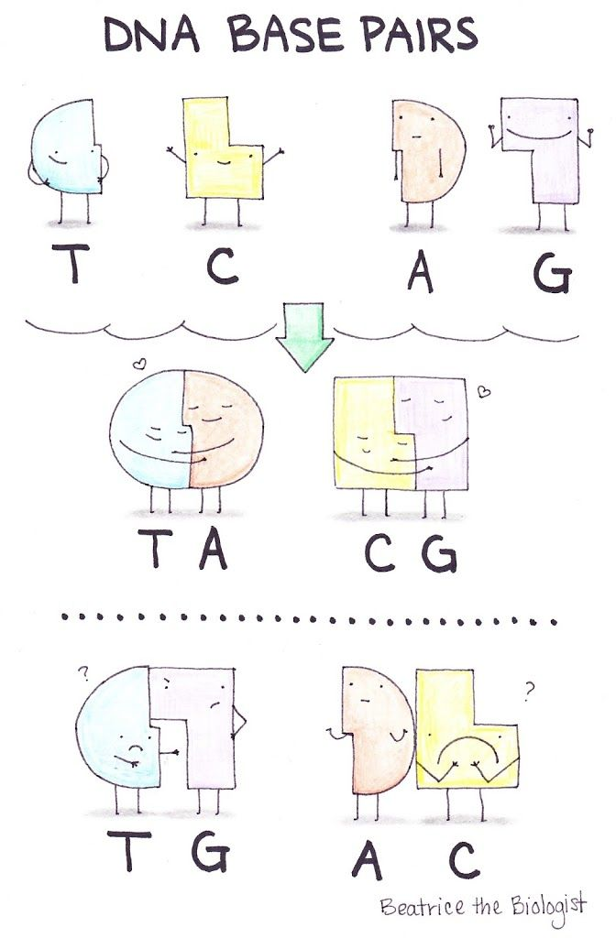
DNA Base Pairs
C-G
A-T

Slide 30
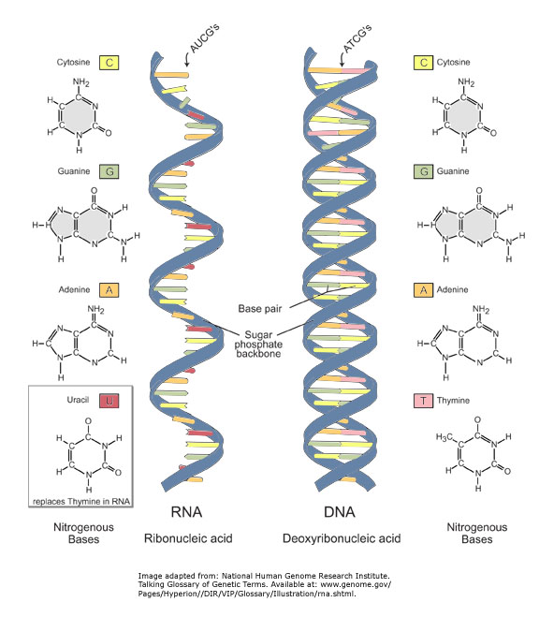
RNA
Ribonucleic Acid
5-C sugar is ribose
Phosphate group
Nitrogenous bases: adenine, uracil, cytosine, guanine
Single stranded

Slide 31
RNA Base Pairs
C-G
A-U

Slide 32
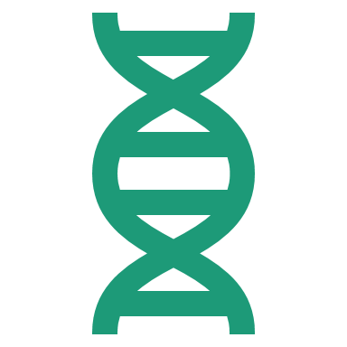
Nucleic Acid Review
What makes up a nucleotide?
Compare DNA and RNA
What are the base pairings for DNA and RNA?
What is meant by sugar-phosphate backbone?

Slide 33
Homework Packet
Due on Friday!

Slide 34
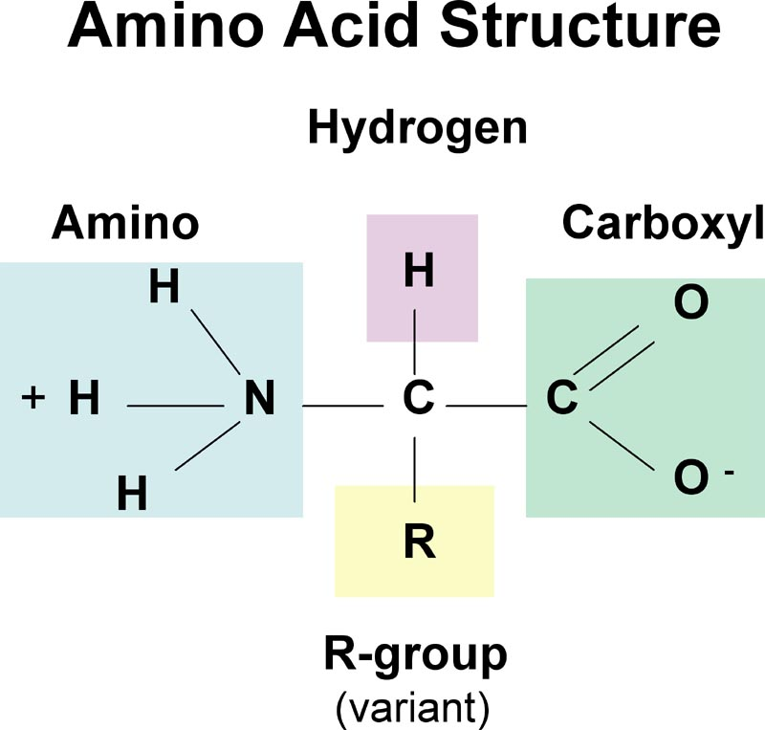
Proteins
Contains carbon, hydrogen, oxygen and nitrogen
Monomers=amino acids
Each contains an amino group, a carboxyl acid group and a R-group.
There are 20 different types of amino acids
The R-groups can be acidic or basic, polar or nonpolar.

Slide 35
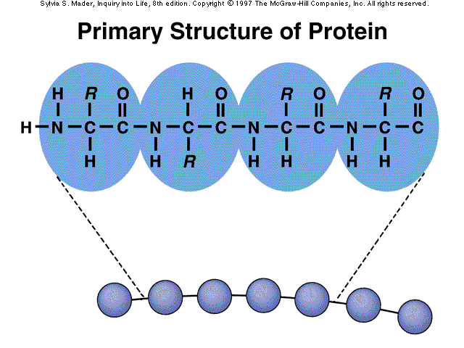
Formation? 4 steps
Primary Level
Peptide Bonds!
(Polypeptides)

Slide 36
Secondary level

Slide 37
Tertiary Level

Slide 38
Quaternary Level

Slide 39
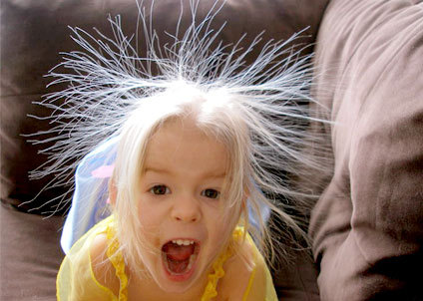
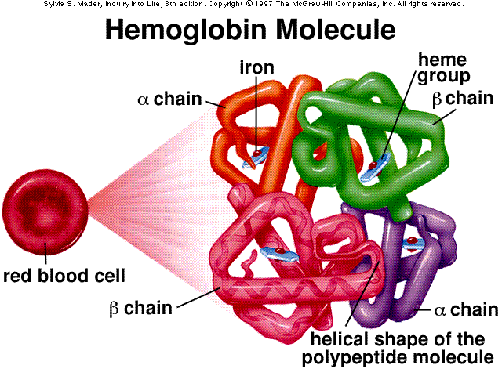
Function?
Structure defines function.
1. Structural:
collagen in skin, keratin in hair, crystallin in eye, muscle, bone
2. Enzymes:
speeds up chemical reactions
3. Transport:
hemoglobin
4. Fight disease
antibodies

Slide 40
Protein Shape
Held in place by:
Ionic bonds
Covalent bonds
Van der Waals forces
Hydrogen bonds

Slide 41
Protein Review
What functional groups make up an amino acid? (Amino group, R group, Acid)- Draw and label an amino acid.
What are some of the important biological functions of proteins? (List and give an example)
List and briefly describe the four levels of protein folding/structure.
What is fundamental to protein structure and function?

Slide 42
Review Macromolecuels!
Get with a partner (near by) Use paper/markers to organize the following at add to your notes.
1. Carbohydrates: Graphic organizer -Handout
2. Lipids: 4 types, and their functions(create your own organizer)
3. Nucleic Acids: 2 types, compare and contrast. Nucleotide base pairing
4. Proteins: What are the monomers? What are the four levels of organization?Functions?

Slide 43
Homework Packet
Due on Friday!

Slide 44
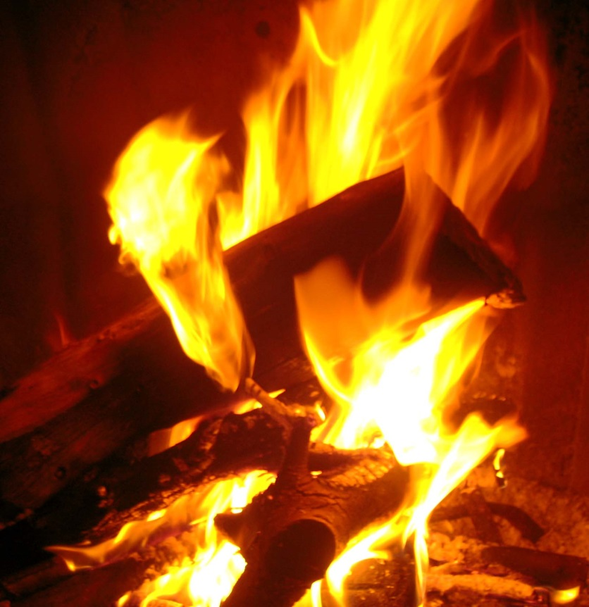
Chemical Reactions
Process by which new substances are produced
3 steps
Old bonds are broken
Atoms are rearranged
New bonds are formed

Slide 45
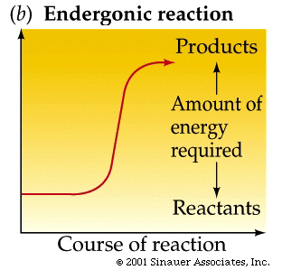
Endergonic Chemical Reactions
energy is absorbed
Dehydration reaction

Slide 46
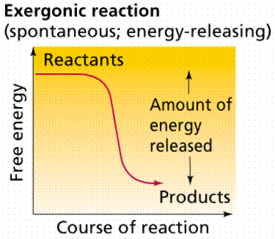
Exergonic Chemical Reactions
energy is "lost"
Hydrolysis reactions

Slide 48
Activation Energy
Amount of energy needed to get a chemical reaction started

Slide 49
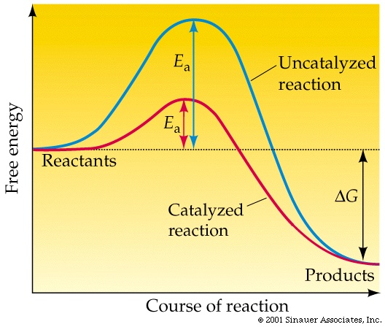
Enzymes
Catalysts are substances that speed up the rate of chemical reactions by lowering the amount of activation energy needed
Enzymes are proteins that act as catalysts

Slide 50
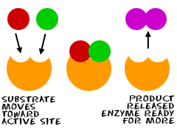
How do enzymes work?
In order for a chemical reaction to take place the reactants must collide together with enough energy to break the old bonds
Enzymes provide a place for the reactants to come together to react
This reduces the amount of energy needed to break the old bonds
The reactants are called substrates which attach to the enzyme to form the enzyme-substrate complex

Slide 52
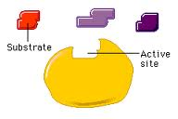
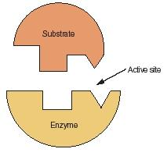
The enzyme has a specific shape so that only certain substrates can attach to the active site
Lock and key mechanism

Slide 53
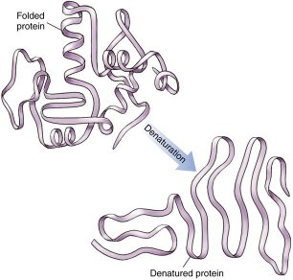
Regulation of Enzyme Activity
Denaturation: processes that cause the enzyme to lose its shape and no longer function
pH
Temperature
salinity

Slide 54
Review Time!
1. Chemical Reactions WS- With a Partner
2. Reviewing Macromolecules!
3. Homework packet due Friday

Slide 55
Review Macromolecuels!
Get with a partner (near by) Use paper/markers to organize the following at add to your notes.
1. Carbohydrates: Graphic organizer -Handout
2. Lipids: 4 types, and their functions(create your own organizer)
3. Nucleic Acids: 2 types, compare and contrast. Nucleotide base pairing
4. Proteins: What are the monomers? What are the four levels of organization?Functions?

Slide 56
Homework Packet
Due on Friday!

